Slide 1


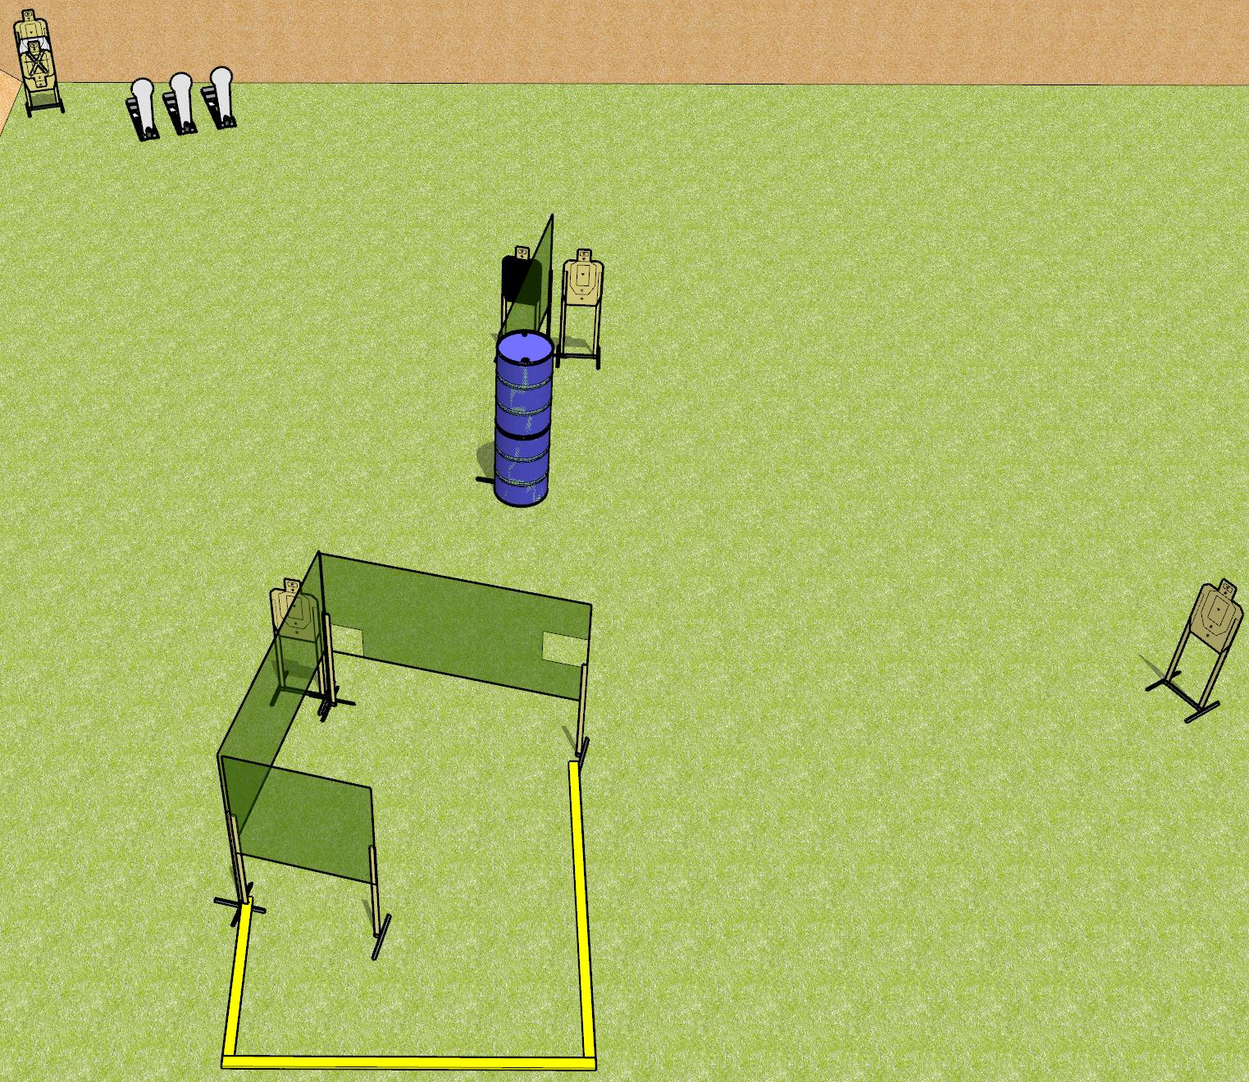
 | Dothan Gun Club – USPSA Match Keanu’s Revenge Course Designer : Drew Coleman
Round Count 15 rounds 6 USPSA 3 colt poppers
Equipment List 6 wall feet 1 medium fault line 1 headshot

Slide 2
Keanu’s Revenge
Written Stage Briefing
Keanu’s Revenge is a 15 round, 75 point, Comstock course of fire. There are 6 USPSA targets and 3 colt poppers. The best 2 hits on paper will score and steel must fall to score. The start signal is audible.
Handgun start position is anywhere completely outside the shooting area, wrists below belt. Handgun is holstered with loaded magazine inserted, empty chamber, hammer down.
PCC start position is anywhere completely outside the shooting area, stock on belt. Carbine is held with both hands, loaded magazine inserted, empty chamber, hammer down.
On start signal, engage targets as they become available from within the shooting area.

